Slide 1

Tchibot The Chatbot
Anahita Gottipati
Chrys Kattirisetti

Slide 2
Consumer Touch Points
Customer Participation
Personalization
Brand Engagement

Slide 3

Customer Participation
Virtual Assistant driven conversation
Enriched digital customer experience
Active customer participation

Slide 4

PersonaliSation
Simplifies product selection
Guided customer journey

Slide 5

Brand Engagement
Personify Tchibo
Establish a sincere brand personality
Introduce a quirky brand element, Tchibot, to enhance brand resonance.

Slide 6
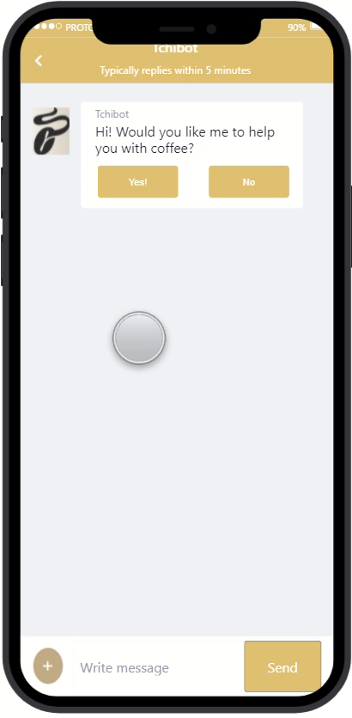

Slide 7
Next steps…
Extend Tchibot interactions for Tchibo range of products.

Slide 8

Thank You

